Slide 1
Data Normalization
Ling Xue

Slide 2
Data Normalization
Normalization
The process of decomposing relations with anomalies (errors or inconsistencies) to produce smaller, well-structured relations.
Primarily a tool to validate and improve a logical design so that it satisfies certain constraints that avoid unnecessary duplication of data.

Slide 3
Goals of Data Normalization
Minimize data redundancy.
Avoid anomalies and conserve storage space.
Simplify the enforcement of referential integrity constraints.
Make it easier to maintain data.
Provide a better design that is an improved representation of the real world and a stronger basis for future growth.

Slide 4
Well-Structured Relations
Contain minimal data redundancy and allow users to insert, delete, and update rows without causing data inconsistencies.
Anomalies (errors or inconsistencies)
Insertion Anomaly–adding new rows forces user to create duplicate data.
Deletion Anomaly–deleting rows may cause a loss of data that would be needed for other future rows.
Modification Anomaly–changing data in a row forces changes to other rows because of duplication.

Slide 5
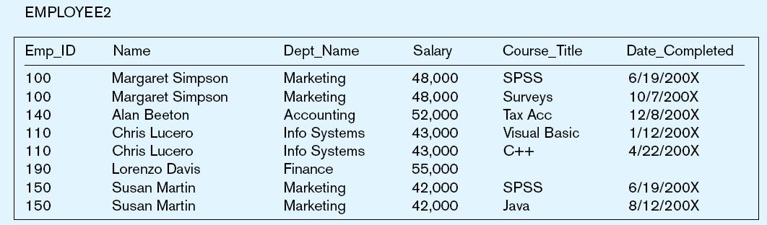
Figure. An Example
Question–Is this a relation?
Yes: Unique rows and no multivalued attributes
Question–What’s the primary key?
Composite: Emp_ID, Course_Title
Notes:
This is a relation. But it is not a well-structured relation.

Slide 6
Anomalies in this Table
Insertion Anomaly
Can’t enter a new employee without having the employee take a class (or at least empty fields of class information).
Insert a row to record an employee completing a course, we have to insert employee name and salary again.
Deletion Anomaly
If we remove employee 140, we lose information about the existence of a Tax Acc class.
Modification (Update) Anomaly
Giving a salary increase to employee 100 forces us to update multiple records.
Why do these anomalies exist?
Two things (entity types) in this one relation!
Data duplication and an unnecessary dependency between the entities!

Slide 7
General Rule of Thumb
A relation should not contain more than one entity type!
If you do a good job in data modeling and logical design, you can have well-structured relations
However, sometimes it may not be so easy…
So,
Normalization can actually complement logical design.

Slide 8
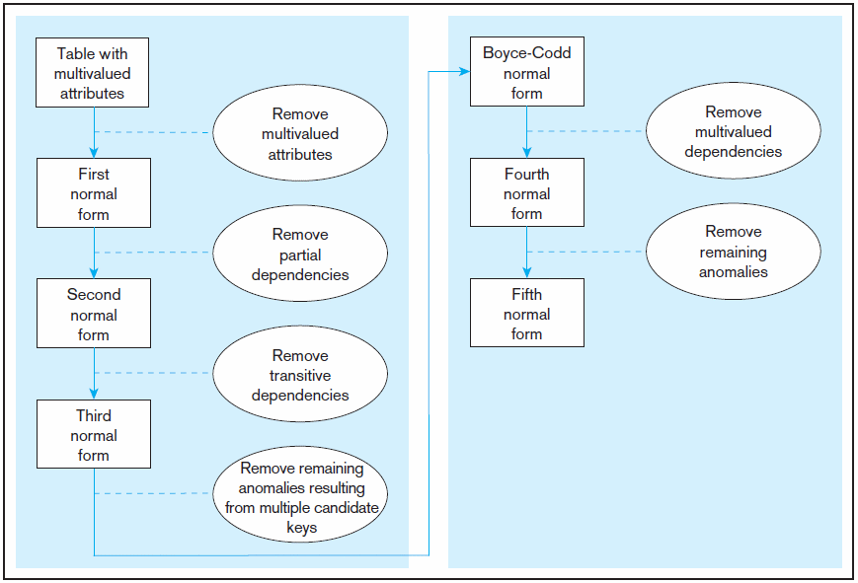
Steps in Normalization: Conform to Rules (Normal Forms)
3rd normal form is generally considered sufficient.

Slide 9
Candidate Keys vs Non-key Fields
Candidate Key
An attribute, or combination of attributes, that uniquely identifies a row in a relation.
Properties
Unique identification
Each nonkey attribute is functionally dependent on that key.
Nonredundancy
No attribute in the key can be deleted without destroying the property of unique identification.
Every candidate key can be the primary key.
E.g. perhaps there is both employeeID and SS# in a table. In this case both are candidate keys.
Each non-key field is functionally dependent on every candidate key.
Notes:
No attribute in the key can be deleted without destroying the property of unique identification

Slide 10
Functional Dependencies
Functional Dependency
A constraint between two attributes in which the value of one attribute determines that of another attribute.
Examples
SSN → Name, Address, Birthdate
VIN → Make, Model, Color
ISBN → Title, First_Author_Name, Publisher
Emp_ID, Course_Title → Date_Completed
Determinants
Attributes on the left-hand side of the arrow in a functional dependency relationship.
And
Notes:
Normalization is based on the analysis of functional dependencies.

Slide 11
First Normal Form
A primary key and no multivalue attribute.
With multivalue attributes, we cannot achieve functional dependency on the primary key or unique identification
Every attribute value is atomic.
All relations with a primary key and without multivalue attribute are in 1st Normal Form.
Notes:
A relation that has a primary key and in which there are no repeating groups.

Slide 12
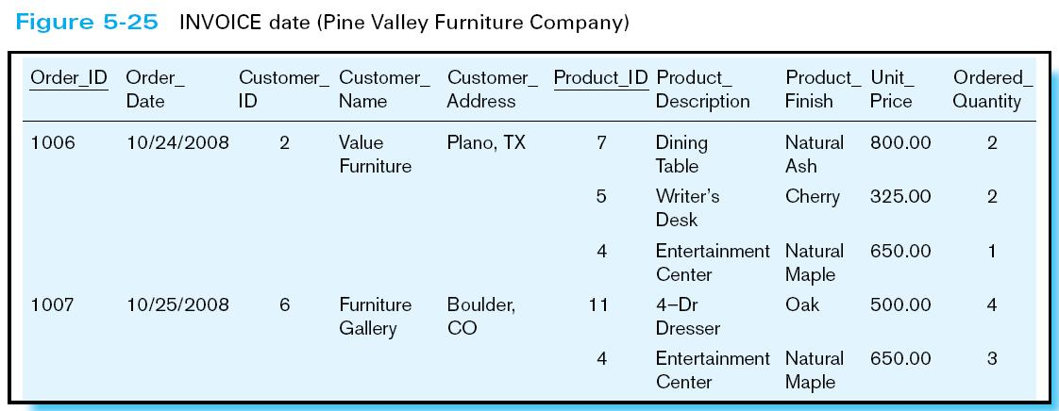
Table with multivalued attributes, not in 1st normal form
Note: this is NOT a relation
Notes:
Basically, we here are violating the principle of “no multivalued attributes”. It’s as if OrderID 1006 has “ProductID” 7, 5, and 4. You can’t have that in a true relation.

Slide 13
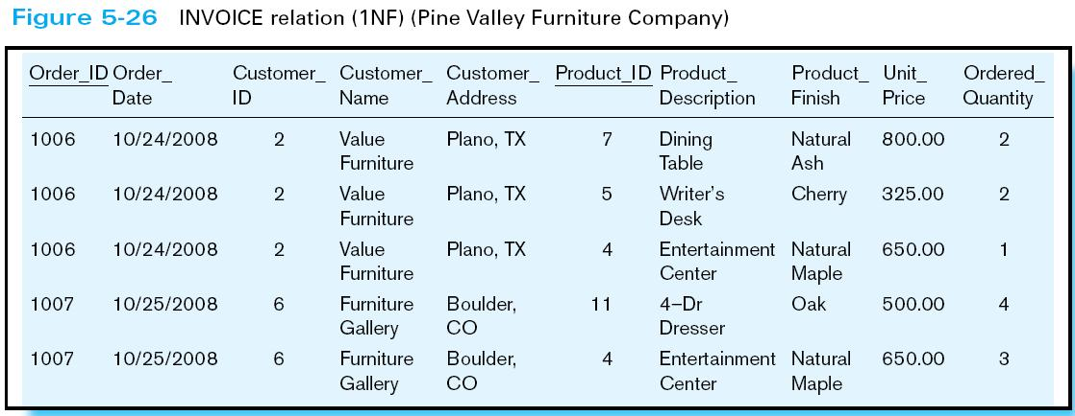
Table with no multivalued attributes and unique rows in 1st normal form
Note: this is a relation, but not a well-structured one
Notes:
Now we have a true relation. It is in first normal form. But note the data duplication. This will cause anomalies.

Slide 14
Anomalies in this Table
Insertion anomaly
If new product is ordered for order 1007 of existing customer, customer data must be re-entered, causing duplication.
Deletion anomaly
If we delete the Dining Table from Order 1006, we lose information concerning this item's finish and price.
Modification (Update) anomaly
Changing the price of product ID 4 requires update in several records.
Why do these anomalies exist?
Because there are multiple entity types in one relation. This results in duplication and an unnecessary dependency between the entities.

Slide 15
Second Normal Form
1NF + no partial functional dependencies.
Partial functional dependency
Non-key attribute is functionally dependent on part (but not all) of the primary key.

Slide 16
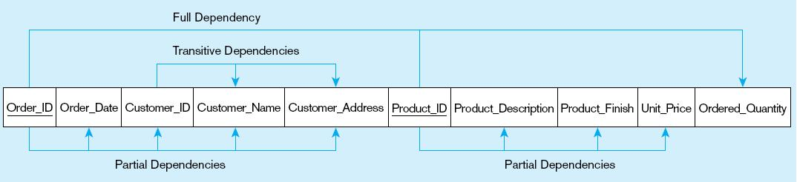
Functional Dependency Diagram for INVOICE
Order_ID ➔ Order_Date, Customer_ID, Customer_Name, Customer_Address
Product_ID ➔ Product_Description, Product_Finish, Unit_Price
Order_ID, Product_ID ➔ Order_Quantity
Therefore, NOT in 2nd Normal Form
Notes:
So, in this one relation, there are partial dependencies. Because of partial dependencies, the relation is not in 2nd normal form. So, our first step is to remove the partial dependencies by splitting the table into three, one for orders, one for products, and one for order line.

Slide 17
Solution
For each determinant in a partial dependency, create a new relation.
The determinant becomes the primary key in the new relation.
Remove the nonkey attributes that are functionally dependent on this primary key attribute from the original relation to the new relation.

Slide 18
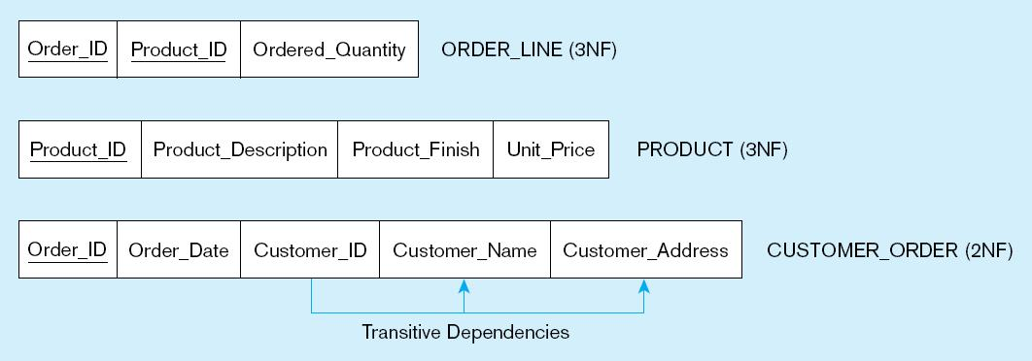
Removing Partial Dependencies
Getting it into Second Normal Form
Partial dependencies are removed

Slide 19
2NF is Achieved When: …
Simple primary key
Cannot be a partial dependency.
No nonkey attributes exist in the relation.
No functional dependencies.
Every nonkey attribute is functionally dependent on the full set of primary key attributes.

Slide 20
Third Normal Form
2NF + no transitive dependencies
Transitive dependencies
Functional dependencies on non-primary-key attributes.
The primary key is a determinant for another attribute, which in turn is a determinant for a third.

Slide 21
Removing Partial Dependencies
Getting it into Second Normal Form
Partial dependencies are removed, but there are still transitive dependencies

Slide 22
Solutions
Non-key determinant with transitive dependencies go into a new relation.
Non-key determinant becomes primary key in the new relation and stays as foreign key in the original relation.
Move all the attributes that are functionally dependent on the attribute from the old to the new relation.

Slide 23
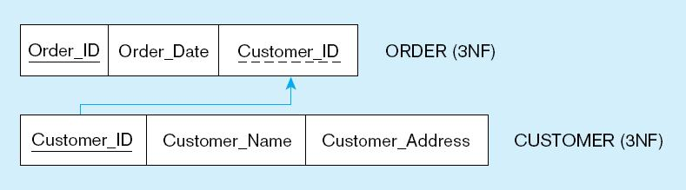
Removing Transitive Dependencies
Getting it into Third Normal Form
Transitive dependencies are removed!
Notes:
Finally we are at third normal form. At this point we have a well-structured database.
Note that if we had started with a thorough ER model, we would not have wound up with one big table containing multiple themes. The original table basically had three separate entities all wrapped into a single relation (customer, product, and order). Furthermore, it hid the fact of a many-to-many relationship between orders and products.
This illustrates the danger of going straight to the logical database design without first performing the conceptual model analysis. But this sort of thing happens all to often.

Slide 24
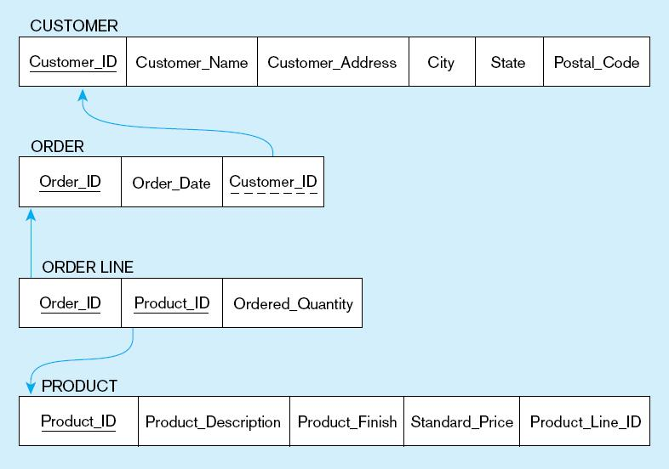
Schema for four relations (Pine Valley Furniture Company)

Slide 25
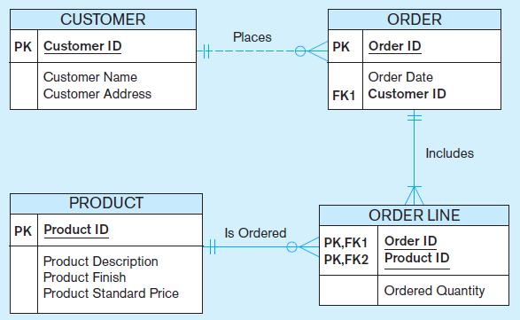
Removing Partial Dependencies
The result of normalization, yielding four separate relations where initially there was only one.

Slide 26
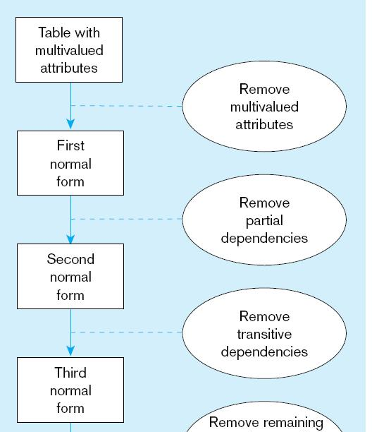
Steps in Normalization

